Slide 1
PRIMITIVE TYPES

Slide 2
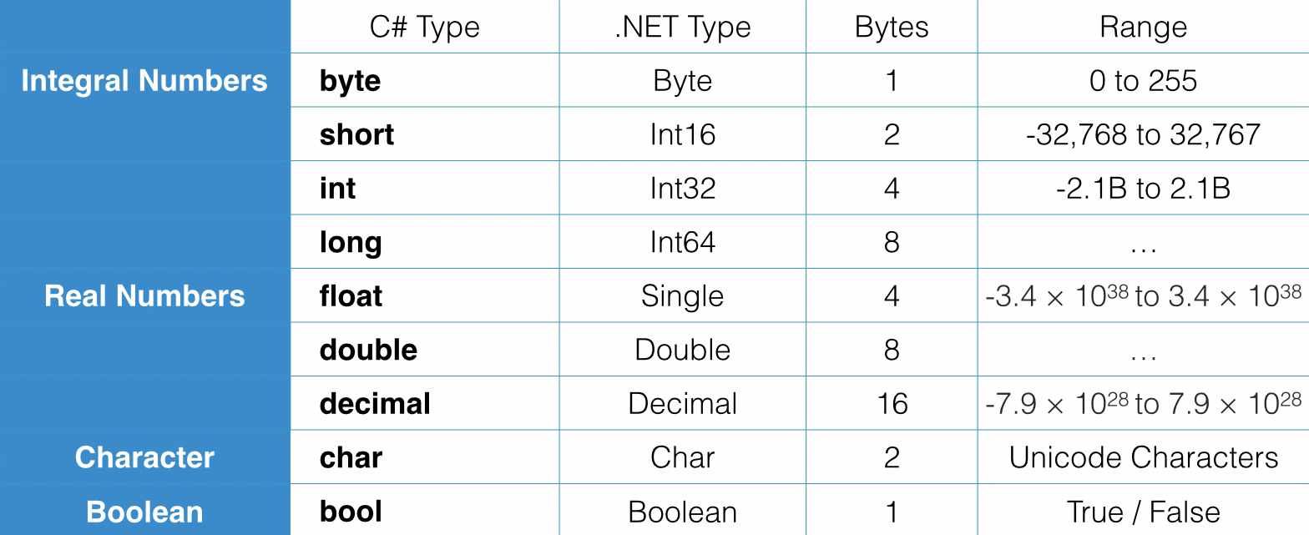

Slide 3
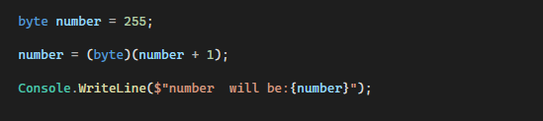

Overflowing

Slide 4
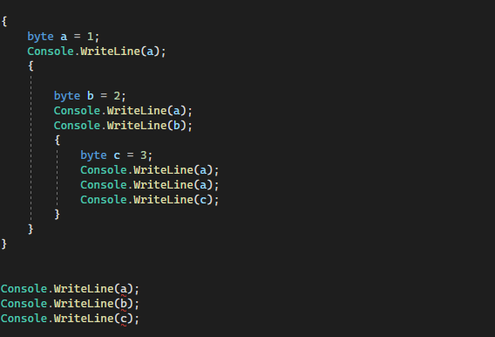
Scope
Scope is where a variable or a constant has a meaning

